Slide 1

Data Communication and Computer Networks
5. Transport Layer
PART-B
Dr. Aiman Hanna
Department of Computer Science & Software Engineering Concordia University, Montreal, Canada
These slides has mainly been extracted, modified and updated from original slides of : Computer Networking: A Top Down Approach, 6th edition Jim Kurose, Keith Ross Addison-Wesley, 2013
Additional materials have been extracted, modified and updated from: Understanding Communications and Networking, 3e by William A. Shay 2005
Copyright © 1996-2013 J.F Kurose and K.W. Ross
Copyright © 2005 William A. Shay
Copyright © 2018 Aiman Hanna All rights reserved

Slide 2
TCP: Overview RFCs: 793,1122,1323, 2018, 2581
full duplex data:
bi-directional data flow in same connection
MSS: maximum segment size; controls amount of sent data (excluding headers)
connection-oriented:
3-way handshake (exchange of control msgs) before data exchange
flow controlled:
sender will not overwhelm receiver
point-to-point:
only one sender, one receiver
reliable, in-order byte steam:
no loss or alteration of data
pipelined:
TCP congestion and flow control set window size
Transport Layer B
3-‹#›

Slide 3
TCP segment structure
URG: urgent data
(generally not used)
32 bits
ACK: ACK #
valid indicating segment successfully received
source port #
dest port #
counting
by bytes
of data
(not segments!)
sequence number
acknowledgement number
PSH: for receiver to push data immediately to upper layer
(generally not used)
head
len
not
used
U
receive window
A
P
R
S
F
# bytes
rcvr willing
to accept;
Needed for flow control
checksum
Urg data pointer
options (variable length)
RST, SYN, FIN:
Connection estbl. (setup, teardown
commands)
application
data
(variable length)
Internet checksum
(as in UDP)
used for sender and receiver negotiation of MSS
Transport Layer B
3-‹#›

Slide 4
TCP seq. numbers, ACKs
sequence numbers:
byte stream “number” of first byte in segment’s data
Ex: sender wishes to send 500,000 bytes, where MSS is 1000
Sequence #s are: 0, 1000, 2000, …, 499,000
acknowledgements:
seq # of next byte expected from other side
cumulative ACK
Q: how receiver handles out-of-order segments
A: TCP spec doesn’t say, - up to implementer
outgoing segment from sender
source port #
dest port #
sequence number
acknowledgement number
rwnd
checksum
urg pointer
window size
N
sender sequence number space
sent
ACKed
sent, not-yet ACKed
(“in-flight”)
usable
but not
yet sent
not
usable
incoming segment to sender
source port #
dest port #
sequence number
acknowledgement number
A
rwnd
checksum
urg pointer
Transport Layer B
3-‹#›

Slide 5

TCP seq. numbers, ACKs
Host A
Host B
User
types
‘C’
Seq=42, ACK=79, data = ‘C’
host ACKs receipt of
‘C’, echoes
back ‘C’
Seq=79, ACK=43, data = ‘C’
host ACKs receipt
of echoed
‘C’
Seq=43, ACK=80
simple Telnet scenario
Transport Layer B
3-‹#›

Slide 6
TCP round trip time, timeout
Q: how to set TCP timeout value?
must be longer than RTT
but RTT varies
too short: premature timeout, unnecessary retransmissions
too long: slow reaction to segment loss
Q: how to estimate RTT?
SampleRTT: measured time from segment transmission until ACK receipt
ignore retransmissions
SampleRTT will vary, want estimated RTT “smoother”
average several recent measurements, not just current SampleRTT
Transport Layer B
3-‹#›

Slide 7
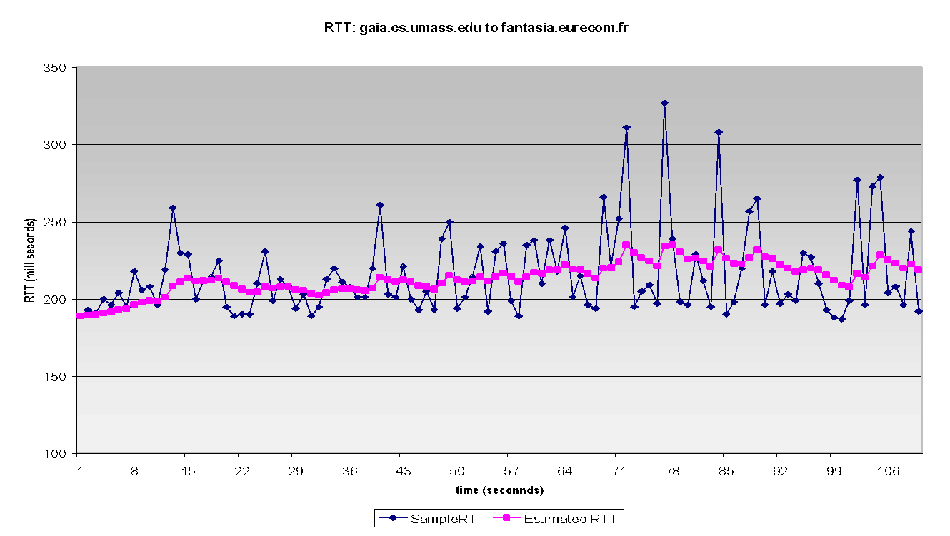
TCP round trip time, timeout
EstimatedRTT = (1- α)* EstimatedRTT + α * SampleRTT
exponential weighted moving average
weight of a given sample decays exponentially fast as updates proceed
typical value: α = 0.125; hence much more load is given to last sample
RTT: gaia.cs.umass.edu to fantasia.eurecom.fr
RTT (milliseconds)
sampleRTT
EstimatedRTT
time (seconds)
Transport Layer B
3-‹#›

Slide 8

TCP round trip time, timeout
timeout interval: EstimatedRTT plus “safety margin”
large variation in EstimatedRTT -> larger safety margin
estimate SampleRTT deviation from EstimatedRTT:
DevRTT = (1-β)*DevRTT +
β*|SampleRTT-EstimatedRTT|
(typically, β = 0.25)
TimeoutInterval = EstimatedRTT + 4*DevRTT
estimated RTT
“safety margin”
Transport Layer B
3-‹#›

Slide 9
TCP reliable data transfer
TCP creates rdt service on top of IP’s unreliable service
pipelined segments
cumulative acks
single retransmission timer
retransmissions triggered by:
timeout events
duplicate acks
let’s initially consider simplified TCP sender:
ignore duplicate acks
ignore flow control and congestion control
Transport Layer B
3-‹#›

Slide 10
TCP sender events:
data rcvd from app:
create segment with seq #
seq # is byte-stream number of first data byte in segment
start timer if not already running
think of timer as for oldest unacked segment
expiration interval: TimeOutInterval
timeout:
retransmit segment that caused timeout
restart timer
ack rcvd:
if ack acknowledges previously unacked segments
update what is known to be ACKed
start timer if there are still unacked segments
Transport Layer B
3-‹#›

Slide 11
TCP sender (simplified)
data received from application above
create segment, seq. #: NextSeqNum
pass segment to IP (i.e., “send”)
NextSeqNum = NextSeqNum + length(data)
if (timer currently not running)
start timer
Λ
NextSeqNum = InitialSeqNum
SendBase = InitialSeqNum
wait
for
event
timeout
retransmit not-yet-acked segment with smallest seq. #
start timer
ACK received, with ACK field value y
if (y > SendBase) {
SendBase = y
/* SendBase–1: last cumulatively ACKed byte */
if (there are currently not-yet-acked segments)
start timer
else stop timer
}
Transport Layer B
3-‹#›

Slide 12
TCP: retransmission scenarios
Host A
Host B
Host A
Host B
SendBase=92
Seq=92, 8 bytes of data
Seq=92, 8 bytes of data
timeout
ACK=100
timeout
Seq=100, 20 bytes of data
X
ACK=100
ACK=120
Seq=92, 8 bytes of data
Seq=92, 8
bytes of data
SendBase=100
SendBase=120
ACK=100
ACK=120
SendBase=120
lost ACK scenario
premature timeout
Transport Layer B
3-‹#›

Slide 13
TCP: retransmission scenarios
Host A
Host B
SendBase=92
Seq=92, 8 bytes of data
Seq=100, 20 bytes of data
timeout
ACK=100
X
ACK=120
SendBase=120
Seq=120, 15 bytes of data
cumulative ACK
Transport Layer B
3-‹#›

Slide 14
TCP ACK generation [RFC 1122, RFC 2581]
event at receiver
arrival of in-order segment with
expected seq #. All data up to
expected seq # already ACKed
arrival of in-order segment with
expected seq #. One other
segment has ACK pending
arrival of out-of-order segment
higher-than-expect seq. # .
Gap detected
arrival of segment that
partially or completely fills gap
TCP receiver action
delayed ACK. Wait up to 500ms
for next segment. If no next segment,
send ACK
immediately send single cumulative
ACK, ACKing both in-order segments
immediately send duplicate ACK,
indicating seq. # of next expected byte
immediate send ACK, provided that
segment starts at lower end of gap
Transport Layer B
3-‹#›

Slide 15
TCP fast retransmit
time-out period often relatively long:
long delay before resending lost packet
detect lost segments via duplicate ACKs.
sender often sends many segments back-to-back
if segment is lost, there will likely be many duplicate ACKs.
TCP fast retransmit
if sender receives 3 additional ACKs for the same data
(“triple duplicate ACKs”), immediately resend unacked segment with smallest seq #
likely that unacked segment lost, so don’t wait for timeout
Transport Layer B
3-‹#›

Slide 16
TCP fast retransmit
Host A
Host B
Seq=92, 8 bytes of data
Seq=100, 20 bytes of data
X
ACK=100
timeout
ACK=100
ACK=100
ACK=100
Seq=100, 20 bytes of data
fast retransmit after sender
receipt of triple duplicate ACK
Transport Layer B
3-‹#›

Slide 17
TCP: Go-Back-N or Selective Repeat?
“seems” like a GBN since sender maintains the smallest unacked seq # (SendBase), but there are striking differences between TCP operations and GBN
most TCP implementation would buffer out-of-order segments
Assume sender sent segments 1 to N, and all arrived correctly, but ACK_{i} for i < N is lost, and the rest of the ACKs are received afterwards:
GBN: retransmits ALL segments from i onward
TCP: retransmits at most one segment (seg # i)
➔ In fact, TCP may not even retransmit seg # i, if ACK for any segment with a sequence # > i arrives before timer times-out for segment i
proposed modifications to TCP: Selective Acknowledgment
Transport Layer B
3-‹#›

Slide 18
TCP flow control
application
process
application may
remove data from
TCP socket buffers ….
application
TCP socket
receiver buffers
OS
… slower than TCP
receiver is delivering
(sender is sending)
TCP
code
flow control
IP
code
receiver controls sender, so sender won’t overflow receiver’s buffer by transmitting too much, too fast
from sender
receiver protocol stack
Transport Layer B
3-‹#›

Slide 19
TCP flow control
receiver “advertises” free buffer space by including rwnd value in TCP header of receiver-to-sender segments
RcvBuffer size set via socket options (typical default is 4096 bytes)
many operating systems autoadjust RcvBuffer
sender limits amount of unacked (“in-flight”) data to receiver’s rwnd value
guarantees receive buffer will not overflow
Is there a technical problem here?
to application process
RcvBuffer
buffered data
rwnd
free buffer space
TCP segment payloads
receiver-side buffering
Transport Layer B
3-‹#›

Slide 20
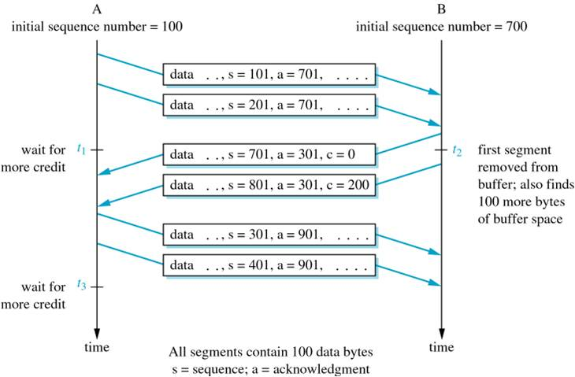
TCP flow control
Flow Control Using a Credit Mechanism
Transport Layer B
3-‹#›

Slide 21
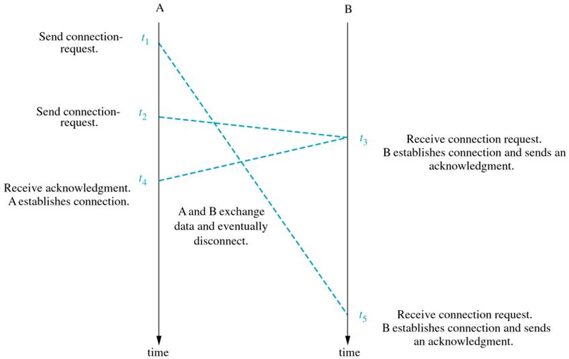
TCP connection management
Establishing a connection may seem easy; one end request a connection, the other end accepts; that is two-way handshaking
Why does it fail?
Failure of 2-way Handshake Protocol
Transport Layer B
3-‹#›

Slide 22
Agreeing to establish a connection
2-way handshake failure scenarios:
choose x
req_conn(x)
choose x
req_conn(x)
ESTAB
ESTAB
retransmit
req_conn(x)
acc_conn(x)
retransmit
req_conn(x)
acc_conn(x)
ESTAB
ESTAB
data(x+1)
req_conn(x)
accept
data(x+1)
retransmit
data(x+1)
connection
x completes
connection
x completes
client terminates
server
forgets x
client terminates
server
forgets x
req_conn(x)
ESTAB
data(x+1)
ESTAB
half open connection!
(no client!)
accept
data(x+1)
Transport Layer B
3-‹#›

Slide 23
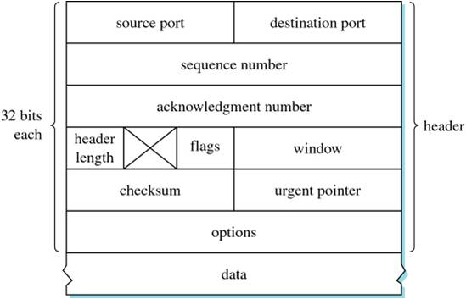
TCP connection management
Recall TCP segment structure
32-bit for sequence # field, so it allows more than 4 billion sequence numbers
TCP Segment
Transport Layer B
3-‹#›

Slide 24
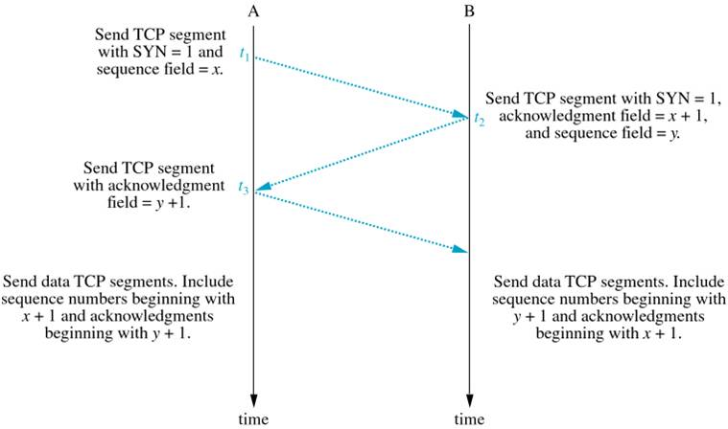
TCP connection management
TCP uses three-way handshaking instead
3-way Handshake Protocol
Transport Layer B
3-‹#›

Slide 25
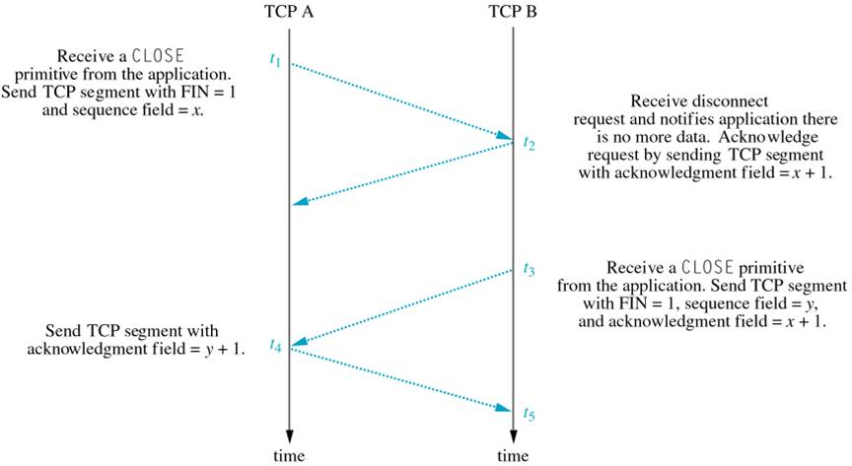
TCP connection management
TCP again uses three-way handshaking to disconnect
TCP Disconnect Protocol
Transport Layer B
3-‹#›

Slide 26
Principles of congestion control
congestion:
informally: “too many sources sending too much data too fast for network to handle”
different from flow control!
manifestations:
lost packets (buffer overflow at routers)
long delays (queuing in router buffers)
a top-10 problem!
Transport Layer B
3-‹#›

Slide 27
Principles of congestion control
congestion:
Reasons behind congestion include:
failed link,
number of transmitted packets exceed network capacity,
larger number of nodes than expected,
etc.
Once congested, network suffers delays, possible retransmissions, incapability of a node to receive quickly due to being busy sending (or attempting to send), ..etc.
Transport Layer B
3-‹#›

Slide 28
Approaches towards congestion control
two broad approaches towards congestion control:
end-end congestion control:
no explicit feedback from network
congestion inferred from end-system observed loss, delay
approach taken by TCP
network-assisted congestion control:
routers provide feedback to end systems
single bit indicating congestion (SNA, DECbit, TCP/IP ECN, ATM)
explicit rate for sender to send at
Transport Layer B
3-‹#›

Slide 29
congestion control
there are several ways to handle congestion:
Packet elimination
Flow control
Buffer allocation
Choke packets
Transport Layer B
3-‹#›

Slide 30
congestion control
Congestion – Packet Elimination
if excessive buildup of packets occur at a node, eliminate some of them
this reduces the network load but suffer loss of packets
eventually, the higher level protocol will handle this loss by retransmitting the packets, hoping for sure that the congestion has subsided
Transport Layer B
3-‹#›

Slide 31
congestion control
Congestion – Flow Control
designed to control the number of packets sent, however it is not really a congestion control approach
flow control limits the number of packets between two points, whereas congestion often involves packets coming into a node from many sources
one solution is to limit the number that can be sent by a node, so the total may not congest the network; this has a bad side effect however; what is it?
let the nodes communicate with each others so that one reduces its traffic if total traffic is high; this won’t work either, why?
Transport Layer B
3-‹#›

Slide 32
congestion control
Congestion – Buffer Allocation
very suitable for virtual circuit connections
when the circuit is reserved, a specific amount of buffer is allocated to this communication
further requests for the same circuit will consume other portions of the available buffers
if there is no more buffers, requests to use that circuit will be rejected and the higher level protocol must then find an alternative route
Transport Layer B
3-‹#›

Slide 33
congestion control
Congestion – Choke Packets
more dynamic way to handle congestion
each node monitors the activity on its outgoing links and traces the utilization of the links
an increased utilization indicates higher risk of congestion
if the utilization exceeds specific threshold, the node is put into a warning state
while in the warning state, if the node receives a packet for further forwarding, it will respond by sending special choke packet to the sender
when the sender receives a choke packet, it knows that congestion risk is high and hence reduces the number of sent packets for a period of time
if the time expires without receiving any further choke packets, the sender goes back to its normal transmission rate; otherwise, it reduces the number of sent packets even further
Transport Layer B
3-‹#›

Slide 34
TCP congestion control
TCP uses end-to-end congestion control since the IP layer provides no explicit feedback regarding congestion
three important questions:
how can TCP detect network congestion?
what can it do to limit transmission into congested connection?
how can transmission be adjusted as perceived congestion changes?
Transport Layer B
3-‹#›

Slide 35
TCP congestion control
how can TCP detect network congestion?
if loss occurs (or suspected) then:
sender times out, or
three duplicate ACKs are received
what does TCP do to limit transmission?
maintains a congestion-window (cwnd) that imposes constraints on the sender’s transmission rate
this window decreases when congestion is suspected and increases when network is healthy
Transport Layer B
3-‹#›

Slide 36
TCP congestion control: additive increase multiplicative decrease (AIMD)
how can transmission be adjusted as perceived congestion changes?
transmitting too fast has the potential of congesting the network
transmitting too slow has the potential of under-utilizing the network
approach: sender increases transmission rate, probing for usable bandwidth, until loss occurs
additive increase: increase transmission additively (i.e. add 1MSS, or double MSS, every RTT) until loss detected
multiplicative decrease: cut transmission rate (i.e. in half, or put it down to 1MSS) after loss
Transport Layer B
3-‹#›

Slide 37
TCP Slow Start
Host A
Host B
when connection begins, increase rate exponentially until first loss event:
initially cwnd = 1 MSS
double cwnd every RTT
done by incrementing cwnd for every ACK received
summary: initial rate is slow but ramps up exponentially fast
one segment
RTT
two segments
four segments
time
Transport Layer B
3-‹#›

Slide 38
TCP: detecting, reacting to loss
loss indicated by timeout:
cwnd set to 1 MSS;
window then grows exponentially (as in slow start) to threshold, then grows linearly
loss indicated by 3 duplicate ACKs: TCP RENO
dup ACKs indicate network capable of delivering some segments
cwnd is cut in half window then grows linearly
TCP Tahoe always sets cwnd to 1 (timeout or 3 duplicate acks)
Transport Layer B
3-‹#›

Slide 39
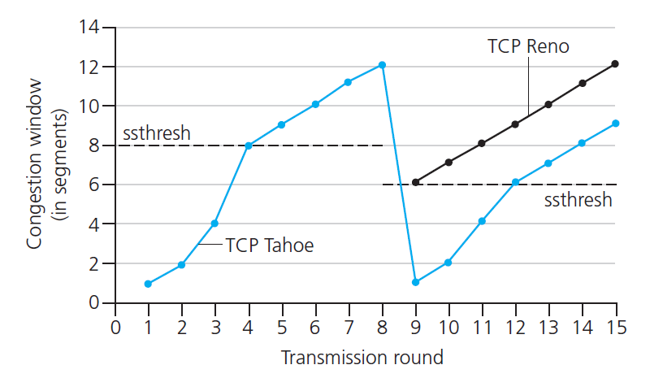
TCP: congestion avoidance
switching from slow-start to congestion avoidance
Q: when should the exponential increase ends?
A: when cwnd gets to 1/2 of its value before timeout. Why?
assume timeout occurs, and the cwnd was set back to 1.
when the increase is made again, it will be reckless to double cwnd size again once your reach ½ of its value since this has high potential of causing congestion again
Transport Layer B
3-‹#›

Slide 40
TCP: congestion avoidance
Implementation:
maintain a variable ssthresh for “slow start threshold”
on loss event, ssthresh is set to 1/2 of the value of cwnd
both TCP RENO, which provides fast recovery, and TCP Tahoe follow this congestion avoidance scheme
Transport Layer B
3-‹#›

Slide 41
TCP throughput
avg. TCP throughput as function of window size, RTT?
ignore slow start, assume always data to send
W: window size (measured in bytes) where loss occurs
transmission ranges, as a highly-simplified estimation, from ½ W to W
avg. window size (# in-flight bytes) is ¾ W
avg. throughput is 3/4W per RTT
3
W
➔ avg TCP throughput =
bytes/sec
4
RTT
W
W/2
Transport Layer A
3-‹#›

Slide 42
TCP over high-bandwidth paths: Do we need a new version of TCP?
example: 1500 byte segments, 100ms RTT, want to achieve 10 Gbps throughput
requires W = 83,333 in-flight segments
but some segments may be lost. The question is: how much loss can we afford in order to still achieve 10Gbps rate?
throughput in terms of segment loss probability, L: [Mathis 1997] (*NOTE: Details of the equation is irrelevant & out of our scope here):
➜ to achieve 10 Gbps throughput, need a loss rate of L = 2·10⁻¹⁰ (one loss event per 5 billion segment; a very small loss rate!
new versions of TCP for high-speed paths is needed!
1.22
.
MSS
TCP throughput =
RTT
L
Transport Layer A
3-‹#›

Slide 43
TCP Fairness
fairness goal: if K TCP sessions share same bottleneck link of bandwidth R, each should have average rate of R/K
TCP connection 1
bottleneck
router
capacity R
TCP connection 2
Transport Layer B
3-‹#›

Slide 44
Why is TCP fair? Or is it!!
Two competing sessions (assume no other connections and no UDP traffic is passing through that link):
AIMD attempts to be fair, and roughly it is!
additive increase gives slope of 1, as throughout increases
multiplicative decrease decreases throughput proportionally
Full bandwidth utilization line
R
equal bandwidth share line
Connection 2 throughput
loss: decrease window by factor of 2
congestion avoidance: additive increase
loss: decrease window by factor of 2
congestion avoidance: additive increase
Connection 1 throughput
R
Transport Layer B
3-‹#›

Slide 45
is TCP actually fair?
Fairness and UDP
multimedia apps often do not use TCP
do not want rate throttled by congestion control
instead use UDP:
send audio/video at constant rate, tolerate packet loss
Fairness, parallel TCP connections
application can open multiple parallel connections between two hosts
web browsers do this
e.g., link of rate R with 9 existing connections:
new app asks for 1 TCP, gets rate R/10
new app asks for 11 TCPs, gets more than R/2, while each of the other ones gets roughly R/20!
Transport Layer B
3-‹#›

